Slide 1
Chapter 3: Processes(continue)

Slide 2
Chapter 3: Processes
Interprocess Communication
Examples of IPC Systems
Communication in Client-Server Systems

Slide 3
Objectives
To describe the various features of processes, including scheduling, creation and termination, and communication
To describe communication in client-server systems

Slide 4
Interprocess Communication
Processes within a system may be independent or cooperating
Cooperating process can affect or be affected by other processes, including sharing data
Reasons for cooperating processes:
Information sharing
Computation speedup
Modularity
Convenience
Cooperating processes require an interprocess communication (IPC) mechanism
Two models of IPC
Shared memory
Message passing

Slide 5
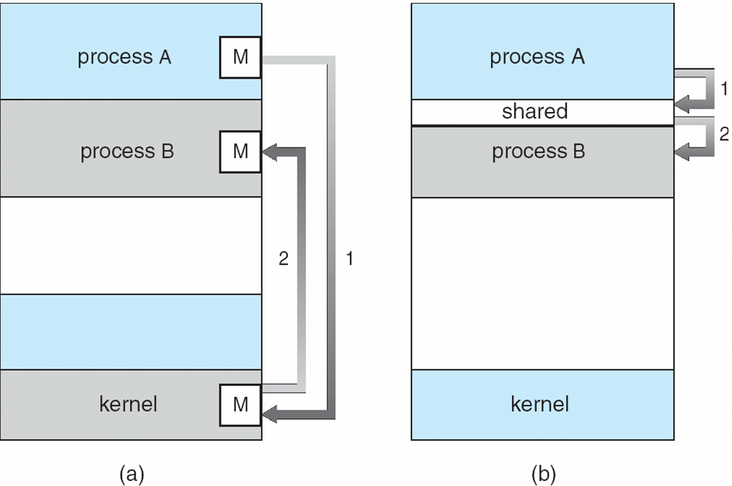
Communications Models

Slide 6
Interprocess Communication (IPC) (Shared Memory)

Slide 7
Shared-Memory Systems
IPC using shared memory requires communicating processes to establish a region of shared memory
The shared memory
Resides in the address space of the process creating the shared memory
Other processes must attach the shared memory to their address space

Slide 8
Producer-Consumer Problem
Paradigm for cooperating processes, producer process produces information that is consumed by a consumer process
unbounded-buffer places no practical limit on the size of the buffer
bounded-buffer assumes that there is a fixed buffer size

Slide 9
Bounded-Buffer – Shared-Memory Solution
Shared data
#define BUFFER_SIZE 10
typedef struct {
. . .
} item;
item buffer[BUFFER_SIZE];
int in = 0;
int out = 0;
Solution is correct, but can only use BUFFER_SIZE elements

Slide 10
Bounded-Buffer – Producer
while (true) { /* Produce an item */
while (((in + 1) % BUFFER SIZE) == out)
; /* do nothing -- no free buffers */
buffer[in] = item;
in = (in + 1) % BUFFER SIZE;
}

Slide 11
Bounded Buffer – Consumer
while (true) {
while (in == out)
; // do nothing -- nothing to consume
// remove an item from the buffer
item = buffer[out];
out = (out + 1) % BUFFER SIZE;
return item;
}

Slide 12
Interprocess Communication – Message Passing
Mechanism for processes to communicate and to synchronize their actions
Message system – processes communicate with each other without sharing the same address space
IPC facility provides two operations:
send(message) – message size fixed or variable
receive(message)
If P and Q wish to communicate, they need to:
establish a communication link between them
exchange messages via send/receive operations
Implementation of communication link
physical (e.g., shared memory, hardware bus, or network)
logical (e.g., logical properties)

Slide 13
Interprocess Communication (IPC) (Message Passing)

Slide 14
Implementation Questions
How are links established?
Can a link be associated with more than two processes?
How many links can there be between every pair of communicating processes?
What is the capacity of a link?
Is the size of a message that the link can accommodate fixed or variable?
Is a link unidirectional or bi-directional?

Slide 15
Logically implementing a link
Here are several methods for logically implementing a link and send()/receive () operations:
Direct or indirect communication
Synchronous or asynchronous communication
Automatic or explicit buffering

Slide 16
Direct Communication
Processes must name each other explicitly:
send (P, message) – send a message to process P
receive(Q, message) – receive a message from process Q
Properties of communication link
Links are established automatically
A link is associated with exactly one pair of communicating processes
Between each pair there exists exactly one link
The link may be unidirectional, but is usually bi-directional

Slide 17
Interprocess Communication (IPC) (Message Passing)

Slide 18
Indirect Communication
Messages are sent to and received from mailboxes (also referred to as ports)
Each mailbox has a unique id
Processes can communicate only if they share a mailbox
Properties of communication link
Link established only if processes share a common mailbox
A link may be associated with many processes
Each pair of processes may share several communication links
Link may be unidirectional or bi-directional

Slide 19
Indirect Communication
Operations
create a new mailbox
send and receive messages through mailbox
destroy a mailbox
Primitives are defined as:
send(A, message) – send a message to mailbox A
receive(A, message) – receive a message from mailbox A

Slide 20
Indirect Communication
Mailbox sharing
P₁, P₂, and P₃ share mailbox A
P₁, sends; P₂ and P₃ receive
Who gets the message?
Solutions
Allow a link to be associated with at most two processes
Allow only one process at a time to execute a receive operation
Allow the system to select arbitrarily the receiver. Sender is notified who the receiver was.

Slide 21
Synchronization
Message passing may be either blocking or non-blocking
Blocking is considered synchronous (rendezvous)
Blocking send has the sender block until the message is received
Blocking receive has the receiver block until a message is available
Non-blocking is considered asynchronous
Non-blocking send has the sender send the message and continue
Non-blocking receive has the receiver receive a valid message or a null

Slide 22
Send and Receive

Slide 23
Send and Receive

Slide 24
Buffering
Queue of messages attached to the link; implemented in one of three ways
Zero capacity – the link cannot have any messages waiting in it. Sender must wait for receiver
Bounded capacity – finite length of n messages Sender must wait if link is full
3. Unbounded capacity – infinite length Sender never waits

Slide 25
Examples of IPC Systems - POSIX
POSIX Shared Memory
Process first creates shared memory segment
segment id = shmget(IPC PRIVATE, size, S IRUSR | S IWUSR);
Process wanting access to that shared memory must attach to it
shared memory = (char *) shmat(id, NULL, 0);
Now the process could write to the shared memory
sprintf(shared memory, "Writing to shared memory");
When done a process can detach the shared memory from its address space
shmdt(shared memory);
Remove from the system
shmct1(segment_id, IPC_RMID,NULL)

Slide 26
Server
#include <sys/types.h>
#include <sys/ipc.h>
#include <sys/shm.h>
#include <stdio.h>
#define SHMSZ 27
main()
{
char c;
int shmid;
key_t key;
char *shm, *s;
key = 5678; /* arbitrary name */
/* Create the segment */
if ((shmid = shmget(key, SHMSZ,
IPC_CREAT | 0666)) < 0) {
perror("shmget"); exit(1);
}
/* Now we attach the segment to our data space */
if ((shm = shmat(shmid, NULL, 0)) == (char *) -1) {
perror("shmat"); exit(1); }
/* Now put some things into the memory for the * other process to read. */
s = shm;
for (c = 'a'; c <= 'z'; c++) *s++ = c;
*s = NULL;
/* wait until the other process changes the first * character of our memory to '*'*/
while (*shm != '*') /* sleep(1) */;
exit(0);
}

Slide 27
Client
#include <sys/types.h>
#include <sys/ipc.h>
#include <sys/shm.h>
#include <stdio.h>
#define SHMSZ 27
main()
{
int shmid;
key_t key;
char *shm, *s;
key = 5678; /* chosen in server */
/* Locate the segment */
if ((shmid = shmget(key,SHMSZ, 0666)) < 0) {
perror("shmget"); exit(1);}
/* attach the segment to our data space */
if ((shm = shmat(shmid, NULL, 0)) == (char *) -1) {
perror("shmat"); exit(1);}
/* Now read what the server put in the memory. */
for (s = shm; *s != NULL; s++) putchar(*s);
putchar('\n');
/* Change the first character of the segment to '*' */
*shm = '*';
exit(0);
}

Slide 28
Examples of IPC Systems - Mach
Mach communication is message based (Carnegie Mellon University)
System calls are made by messages
Each task gets two mailboxes at creation- Kernel and Notify
Only three system calls needed for message transfer
msg_send(), msg_receive(), msg_rpc()
Mailboxes needed for communication, created via
port_allocate()

Slide 29
Examples of IPC Systems – Windows XP
Message-passing centric via local procedure call (LPC) facility
Only works between processes on the same system
Uses ports (like mailboxes) to establish and maintain communication channels
Communication works as follows:
The client opens a handle to the subsystem’s connection port object.
The client sends a connection request.
The server creates two private communication ports and returns the handle to one of them to the client.
The client and server use the corresponding port handle to send messages or callbacks and to listen for replies.

Slide 30
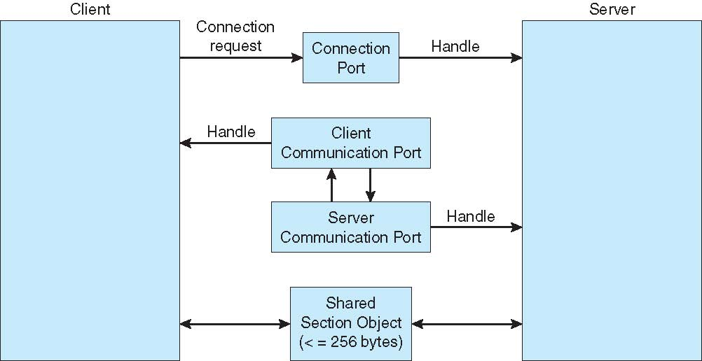
Local Procedure Calls in Windows XP

Slide 31
Client-Server Communication
Other strategies for communication in client-server systems are:
Sockets
Remote Procedure Calls
Pipes

Slide 32
Sockets
Sockets are used to establish communication between processes running in different computers
P1
P2
socket
socket
Message path
Local memory
Local memory

Slide 33
Sockets
A socket is defined as an endpoint for communication
Concatenation of IP address and port
The socket 161.25.19.8:1625 refers to port 1625 on host 161.25.19.8
Communication consists between a pair of sockets

Slide 34
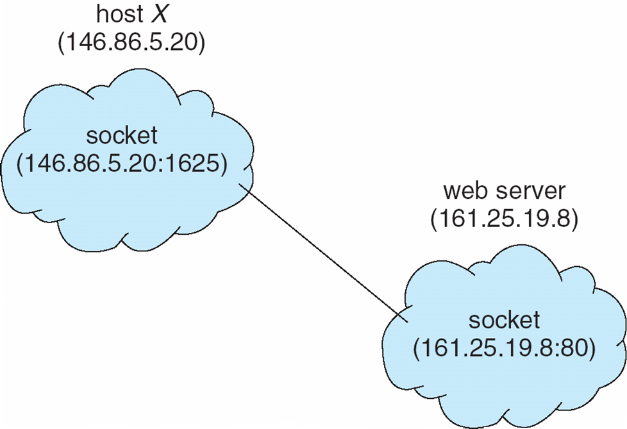
Socket Communication

Slide 35
Sockets
A socket is a virtual connection between two processes running in different computers
Using a socket, two processes can communicate with each other
A socket is identified by an IP address concatenated with a port number

Slide 36
Sockets
The socket is the major communication tool for the Server/Client Model
The server waits for incoming client requests by listening to a specified port
A socket can be created dynamically
A socket is bidirectional

Slide 37
Remote Procedure Calls
Remote procedure call (RPC) was design as a way to abstract procedure calls between processes on networked systems
Stubs – client-side proxy for the actual procedure on the server
The client-side stub locates the server and marshals the parameters
The server-side stub receives this message, unpacks the marshaled parameters, and performs the procedure on the server

Slide 38
Remote Procedure Calls
Stub
Stub
Process A
makes call
Packs parameters
Send message
Receive results
Return results
Receive message
Unpack parameters
Call procedure
Pack results
Send message
parameters
K
E
R
N
E
L
K
E
R
N
E
L
results
results
Local
Remote

Slide 39
Pipes
Acts as a conduit allowing two processes to communicate
Issues
Is communication unidirectional or bidirectional?
In the case of two-way communication, is it half or full-duplex?
Must there exist a relationship (i.e. parent-child) between the communicating processes?
Can the pipes be used over a network?

Slide 40
Ordinary Pipes
Ordinary Pipes allow communication in standard producer-consumer style
Producer writes to one end (the write-end of the pipe)
Consumer reads from the other end (the read-end of the pipe)
Ordinary pipes are therefore unidirectional
Require parent-child relationship between communicating processes

Slide 41
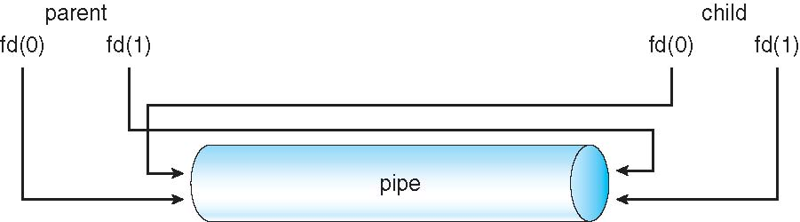
Ordinary Pipes

Slide 42
Named Pipes
Named Pipes are more powerful than ordinary pipes
Communication is bidirectional
No parent-child relationship is necessary between the communicating processes
Several processes can use the named pipe for communication
Provided on both UNIX and Windows systems

Slide 43
End of Chapter 3

